Slide 1

Security in Emergency Situations
Jun Yi, Yiming Peng

Slide 2
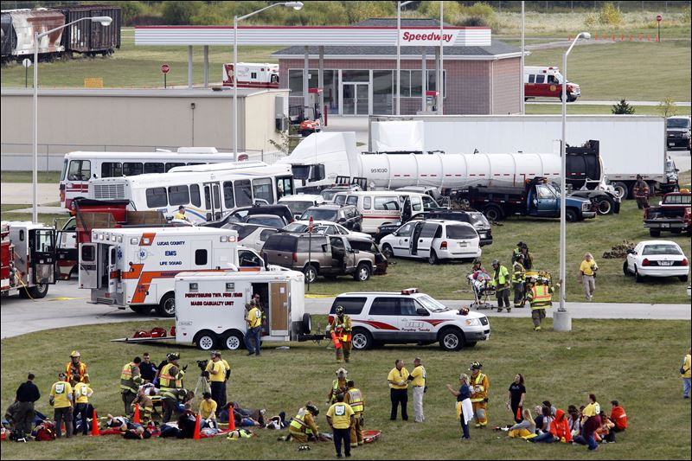
Emergency Situations?
Mass Casualty Incident
Commander
Evacuate
Triage
Responders
Victims

Slide 3
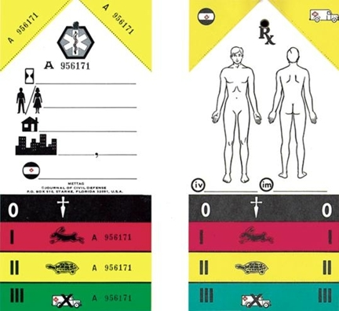
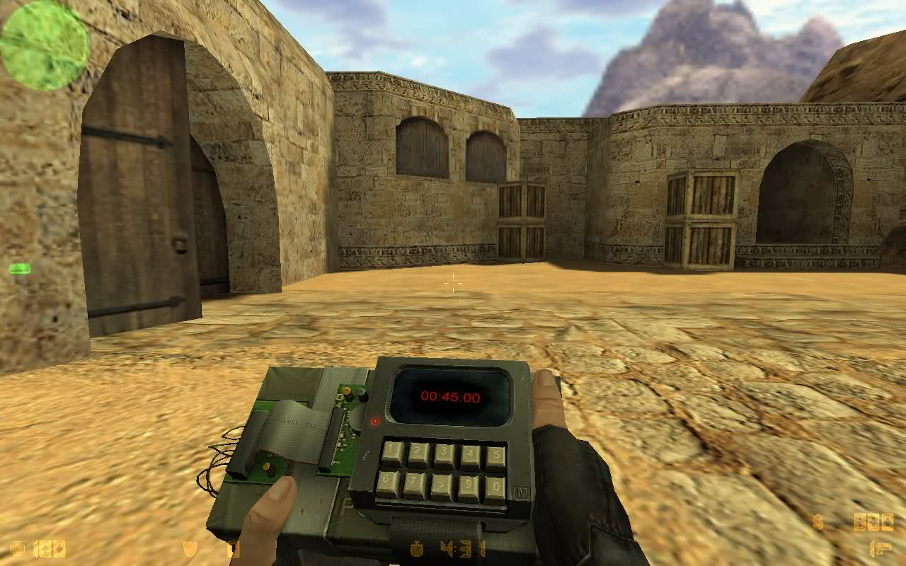


Why Security?
Terrorist Attack
Now, we have:
Name
Sex
Home Address
Cellphone Number
Jun Yi
Male
Whatever St.
Moon
Privacy
Confidentiality

Slide 4


Project GOAL
Increase the Security of Emergency Response System
1.Access Control based on user authorization
Different users can access the data of different secret levels
2.Communication Encryption
An encryption and key distribution protocol based on Kerberos algorithm
3.Different Security Levels
Customized security levels according to different types of incidents
4.Hacker Simulation App
We are under attack~

Slide 5
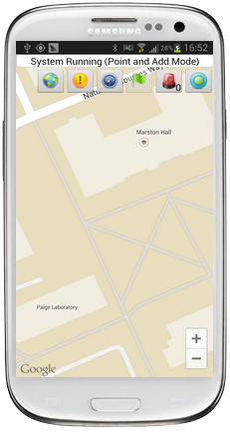

System Component
Kerberos Server
Authentication Server
Administrator
Ticket Granting Server
Data Server
Ticket Check
POI Data Service
Android App
Hack App
Message Service
ASP.NET Web API
SQL Server

Slide 6
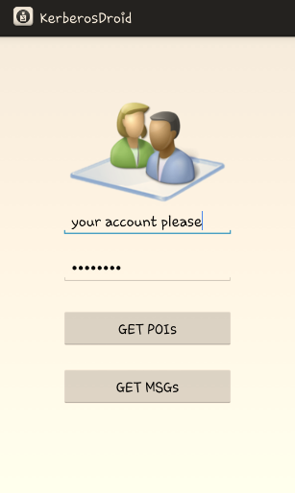
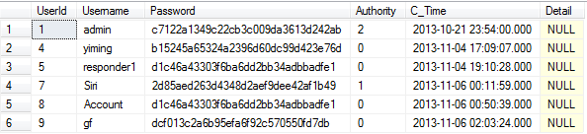
Basic Security
Access Control
User Authority
Administrator
Username
Password
MD5
MD5
c7122a13…
2d85aed2…
c7122a1349c22cb3c009da3613d242a2d85aed263d4348d2aef9dee42af1b49
MD5
b15245a65324a2396d60dc99d423e76

Slide 7
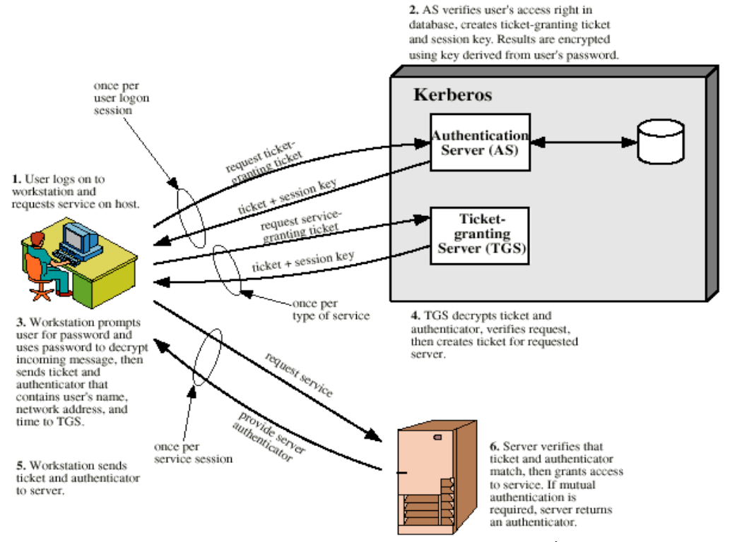
Advanced Security
Communication Encryption
Kerberos
User must identify itself once at the beginning.
Password are never sent across the network.
The communication is encrypted using AES

Slide 8
Communication Encryption
Process of a real communication
Username=“yiming”
TGSname=“TGS”
MacAddress=“9C-4E-36-73-A0-70”
Authentication Server
Request TGS Ticket

Slide 9

Server End
Key_C_TGS=“25B1B0BE7557D346B33D29B2655EF398”
Kerberos Server
E
Authentication Server
User Inf. Database
Authentication Server
User Inf. Database
Key_C_TGS=“qRO7Gs0oYeLF5SSJKVFkXiAbazTlRJi2GAEgcKIh6ZDC1e+0gDydl/TJoPL5BtBN”
Lifetime=“Mlx3MFqjTQLQhe+wAjLzzA==”
Timestamp=“0qmgBajbQWdDrZq3OIAQXvxE40VwOU0hQkeQXa2tDc8=”
Ticket Granting Server
Service Key Database
Data Server
Ticket_TGS
Key_C_TGS=“bOY2S8jv1YRvM61EPFH8jkOwDWgzocy63abfzeYdVsgAXgAFGGPP5HAUAevWPnTx”
MacAddress=“Su9exsjK2CKqXMwq9Rusv3oZq3VAUmcwRrdGtzch53g=“
Authority=“ayrECUycvGwt3s5hLWfdTQ”
Username, TGSname …
Ticket Check
POI Data Service
POI Database
Message Service
Message Database
E
TGS Key Database
Key_TGS

Slide 10
Client End
Key_C_TGS=“25B1B0BE7557D346B33D29B2655EF398”
Lifetime=“3”
Timestamp=“2013/11/6 0:01:57”
Ticket_TGS[…]
Password=“123456”
Key_C_TGS=“qRO7Gs0oYeLF5SSJKVFkXiAbazTlRJi2GAEgcKIh6ZDC1e+0gDydl/TJoPL5BtBN”
Lifetime=“Mlx3MFqjTQLQhe+wAjLzzA==”
Timestamp=“0qmgBajbQWdDrZq3OIAQXvxE40VwOU0hQkeQXa2tDc8=”
HASH
D
Password=“b15245a65324a2396d60dc99d423e76d”
E
Authentication Server
Authenticator
MacAddress=“NsI6EjAa1T6xIJOQnKm+xDYWxAr2Hmuijr+mfdtLoEo=“
Timestamp=“dOy2gJ9yCPKJQCIL8SNBilBK+X8cvcwB0AENA6auLr4=”
Username=“OQZ0Tdh8SRj9ffDMBQazzg==”
Authenticator
MacAddress=“9C-4E-36-73-A0-70“
Timestamp=“2013/11/06 00:41:15”
Username=“yiming”
ServiceName
Ticket_TGS
Ticket Granting Server

Slide 11
Server End
Ticket_TGS
Key_C_TGS=“bOY2S8jv1YRvM61EPFH8jkOwDWgzocy63abfzeYdVsgAXgAFGGPP5HAUAevWPnTx”
MacAddress=“Su9exsjK2CKqXMwq9Rusv3oZq3VAUmcwRrdGtzch53g=“
Authority=“ayrECUycvGwt3s5hLWfdTQ”
Username, TGSname …
Key_TGS
Ticket_TGS
Key_C_TGS=“25B1B0BE7557D346B33D29B2655EF398”
MacAddress=“9C-4E-36-73-A0-70”
Username=“yiming”
UserAuthority=“2”
TGSname=“TGS”
Kerberos Server
Authentication Server
User Inf. Database
D
E
Ticket Granting Server
Ticket Granting Server
Service Key Database
Authenticator
MacAddress=“9C-4E-36-73-A0-70“
Timestamp=“2013/11/06 00:41:15”
Username=“yiming”
Key_C_V=“331D28B7E0BFCFC7B3598A989100B8B6”
Data Server
Ticket Check
POI Data Service
POI Database
Key_C_V, Servicename, Timestamp
Message Service
Message Database
Ticket_Service_1
E
Key_Service_1

Slide 12
Client End
Key_C_V=“331D28B7E0BFCFC7B3598A989100B8B6”
Servicename=“Service_1”
Timestamp=“2013/11/6 0:48:36”
Ticket_Service_1[…]
D
Key_C_TGS
E
Ticket Granting Server
Authenticator
MacAddress=“BG9yXxpAzX5WoYCCQ3t/qTZ7hAG7GkOJv3yM2YBOovY=“
Timestamp=“cL1cigpqOVdA4dQXGqzhkqOZsyumV+Dkpswux6QorY8=”
Username=“0SHMD0EWYrs/GRiDupiUPA==”
Ticket_Service_1
Service_1

Slide 13
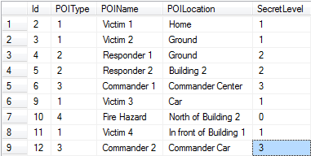
Server End
Ticket_V
Key_C_V=“74A882588777B64C073BB990347ACBD0”
MacAddress=“9C-4E-36-73-A0-70”
Username=“yiming”
UserAuthority=“2”
Servicename=“Service_1”
Kerberos Server
Authentication Server
User Inf. Database
D
Ticket Granting Server
Service Key Database
E
Authenticator
MacAddress=“9C-4E-36-73-A0-70“
Timestamp=“2013/11/06 00:41:15”
Username=“yiming”
Data Server
Ticket Check
Ticket Check
POI Data Service
POI Data Service
POI Database
Message Service
Message Database
POI Information

Slide 14
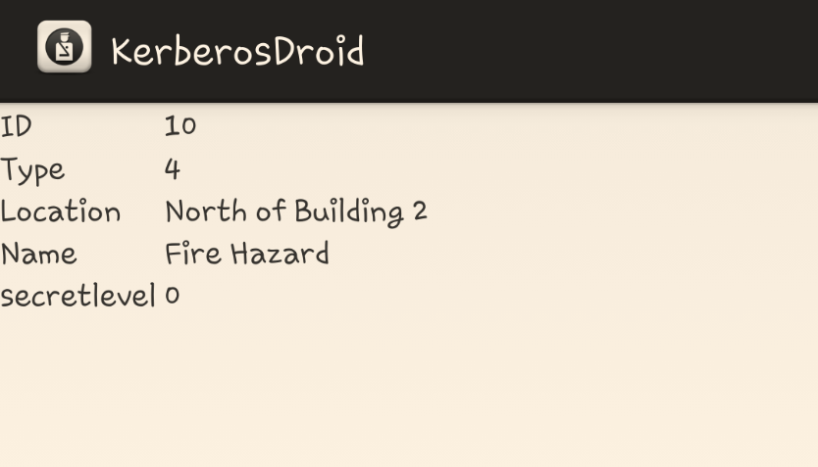
Client End
D
Key_C_V

Slide 15


If we still have time…
Yes
No

Slide 16
More Features
Security Level Options:
Offers the user different security levels
Levels include: Access Control, Kerberos, Database Encryption, Dynamic Session etc.
Balance between security and reaction time
Hacker App
Designed to test the security of the system

Slide 17
Some Problems to Solve
Password transfer in register process
Key storage
Brute-force decryption of session key and ticket
Time synchronization

Slide 18
Thank you!

